Slide 1
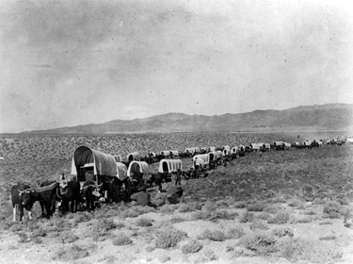
The Oregon Trail

Slide 2
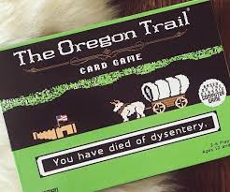
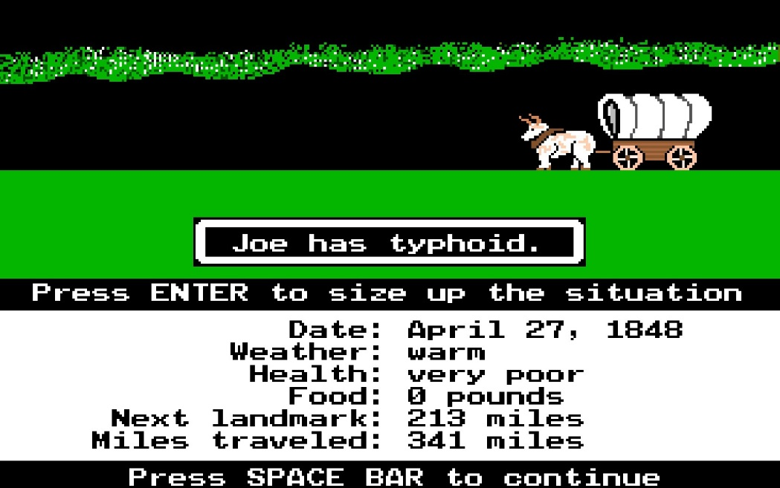
Oregon Trail Lesson
Aimed at S1 – S2, but fun for any age!
Based an outdoor education activity used to teach pioneering. (Also, a popular video game from the 1980’s!)
LESSON APPLICATIONS:
Currency Conversions
Decimals
Rounding
Calculators

Slide 3
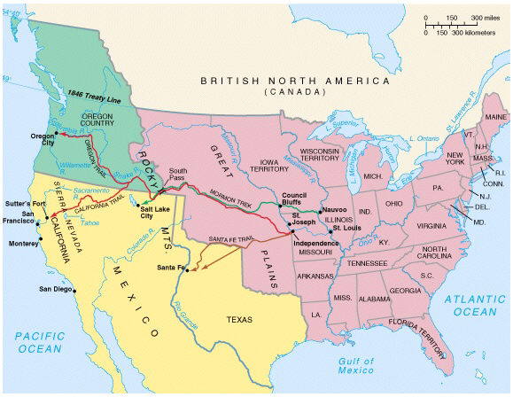
Heading West…
The Oregon trail was the main wagon route to the West between
1840 and 1860. It stretched 2,020 miles from Missouri to Oregon
passing through the Rocky Mountains.

Slide 4
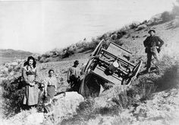
The journey was slow and tough… *Source: “The Oregon Trail” http://www.isu.edu/%7Etrinmich/Allabout.html
Covered wagons would travel over the trail at about 2 mph.
Many had to walk the 2020 miles as their wagons were too full.
In dry weather, air was filled with dust from wheels and hooves.
In wet weather, the trail was a river of mud.
Wagons often broke down, and some were lost in rivers.
Buffalo and Native Americans
One in 10 died along the way, most likely from diseases like cholera and accidental gunshots!
No boats, but eventually trains.

Slide 5
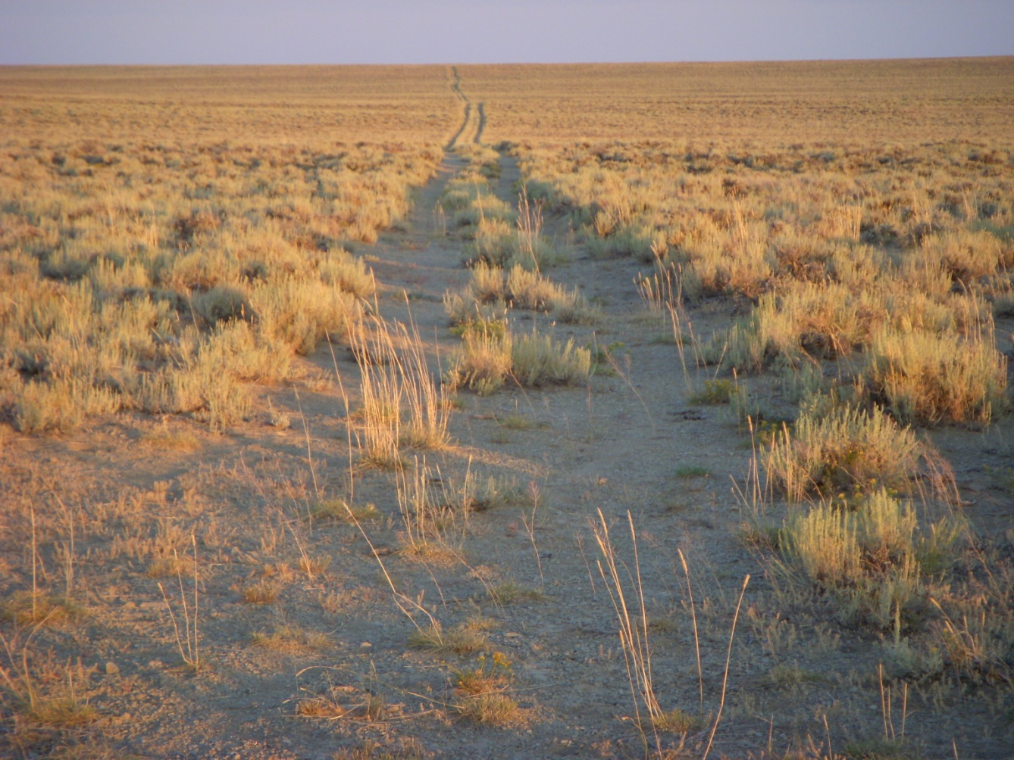
What it looks like today…
The wagon ruts still exist in places! This picture of the trail was taken by Mrs. Gardner in 2008 in Wyoming.

Slide 6
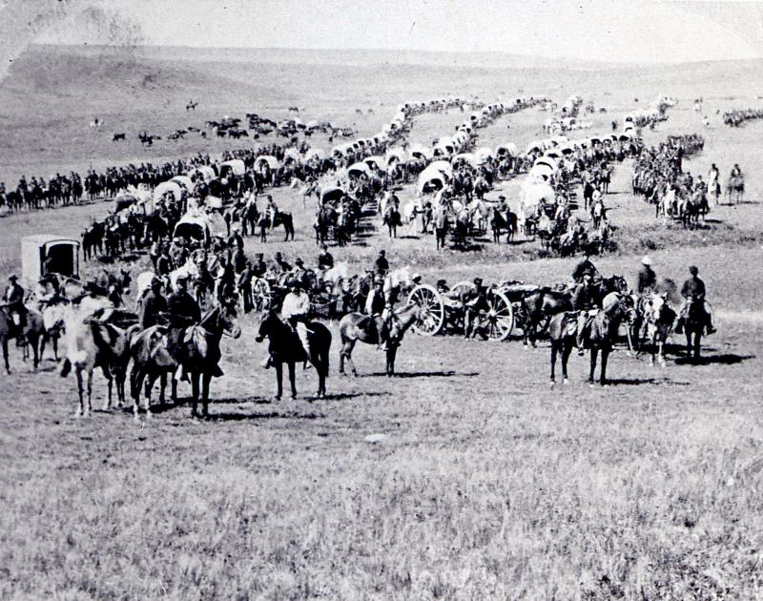
It’s your turn to take the journey…
In spite of the hardships, the trip out west was a great adventure.
Most arrived safely and settled into new farms in Oregon or ventured down to pan for gold in California!
Let’s see how you would handle the trail. Head to the General Store to choose supplies then pack your wagon!

Slide 7
The Scenario
Pair of Oxen 1 point
Sturdy Boots 1 point
Rope 1 point
Hardtack 1 point
Yards of Cloth 1 point
Kettle 1 point
Warm Clothing 1 point
Tinderbox 1 point
Spare Axle OR $5 1 point
Rifle 1 point
Butcher Knife 1 point
Needle and Thread 1 point
Saw 1 point
Plow 1 point

Slide 8
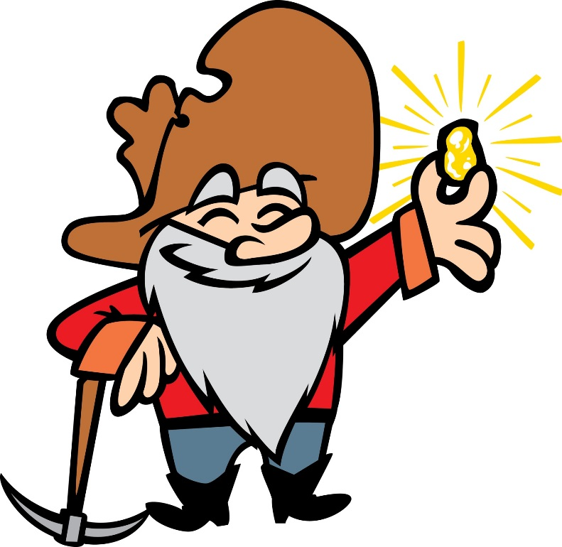
Did you survive?
12-14 points
Everyone survived! Your farm is thriving. You even took little vacation to California and found some gold! So now you’re rich.

Slide 9
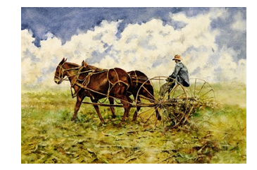
9-11 points
You’ve survived! You’re healthy! Congratulations! The only thing keeping you in this bracket is hard work. Get back to it.

Slide 10
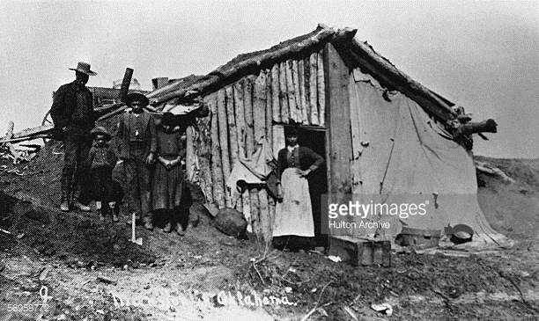
6-8 Points
Everyone survived … for now. Some family members are not in good health. They cannot help with your new cabin or the farming. YOU’RE STRUGGLING! You look like this:

Slide 11
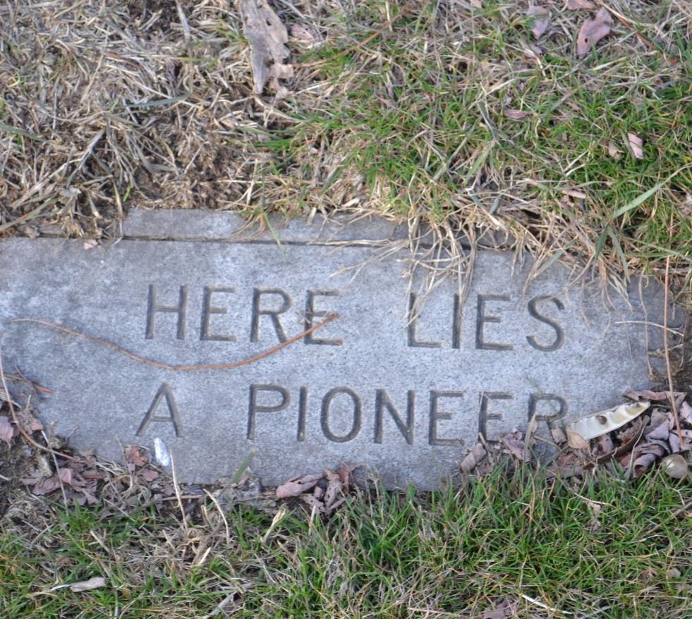
0-5 Points
A family member did not make it to the end of the journey.

Slide 12
For resources, contact me at:
ngardner@st-columbas.org

